Slide 1
Voyage of the Argonauts
Voyage of the Argonauts (2011-2012)
Dandan Zheng
Tharanga Gamaethige

Slide 2
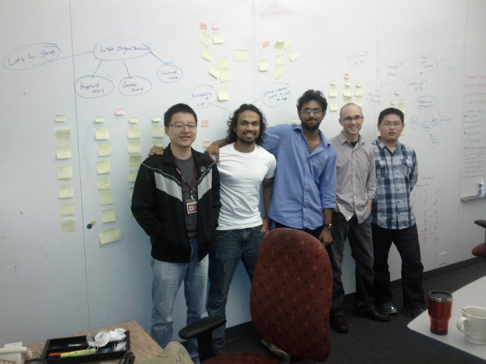
The Argonauts
Siddharth
Matt
Tharanga
Danny
Rui

Slide 3

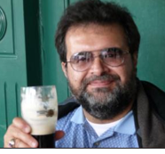

Our Guides
Grace Lewis
Mel Rosso-Llopart
Bradley Schmerl

Slide 4

The Client
A leading provider of energy management
applications for the smart grid
www.enernoc.com
Jake Thompson
Manager of Advanced Technology
EnerNOC, Inc.

Slide 5
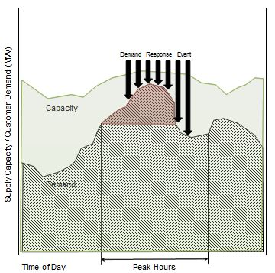
Our Mission – Managing Energy Demand

Slide 6
Our Destination – Reference Architecture
Design and prototype a reference architecture in accordance with the OpenADR 2.0 standard. This architecture should exhibit key quality attributes, such as:
Scalability
Performance
Extensibility
Validate and demonstrate key architectural design decisions

Slide 7
Fall 2011
Activities performed:
Team formation, Project strategy and process establishment, Domain understanding, Ad-hoc requirements
Track
Identify
Assumptions, Constraints, Risks, Issues
Analyze
Notes:
Establish a concrete decision-making process

Slide 8
Fall 2011
Activities performed:
Team formation, Project strategy and process establishment, Domain understanding, Ad-hoc requirements
Identify Initial Problem Space
Validate with Customer
Explore Problem Space
Problem Space Defined
Notes:
Iteratively explore the problem space

Slide 9
Fall 2011
Activities performed:
Team formation, Project strategy and process establishment, Domain understanding, Ad-hoc requirements
Project Objectives
Project Strategy
Course of Action
Accountable Role
Notes:
Operationalize project strategy using courses of action and accountable roles

Slide 10
Spring 2012
Activities performed:
Team re-formation, Structured and iterative requirements gathering, Project scoping, Architecture design
Identify
Continuous Risk Management
Control
Analyze
Communicate
Track
Plan
Notes:
Use a risk-driven approach to track the project in the period of uncertainty.
Risk should help to answer key questions like “to what extent do we document?” or “how long should we spend in design?”

Slide 11
Summer 2012
Activities performed:
Team re-formation, Architecture prototyping, Architecture evaluation
Conceptual Goal
Operational Questions
Quantitative Metrics
Notes:
Base data collection on concrete goals. It will serve its purpose only if data is used for decision-making.

Slide 12
Summer 2012
Activities performed:
Team re-formation, Architecture prototyping, Architecture evaluation
Objective
What is the objective of following a particular process?
Process Description
How should the process be carried out?
Process Analysis
How will we determine whether the process is working or not?
Process Reflection
What are the key takeaways from following the process?
Notes:
Follow the studio process proposal framework to think before you act.

Slide 13
Fall 2012
Activities performed:
Team re-formation, Architecture evaluation, Architecture analysis
Plan
Do Work
Deliver Results
Take Corrective Actions
Measure Progress
Identify Issues, Risks, Opportunities
Notes:
Continue planning and re-planning by taking corrective actions until the end of the project. Planning is not finished until the project is complete.

Slide 14
Our Compass
Discover Architectural Drivers & Establish Project Scope
Followed the Architecture Centric Design Method (ACDM) to develop and evaluate the Reference Architecture.
A
Create/Refine Architecture
B
Architecture Review
C
Production Go/No-Go
Go
Production
Experimentation
D

Slide 15
Our Sails
Formulate Specific, Measurable, Achievable, Realistic, Time-bound objectives, and establish concrete entry and exit criteria for every kind of task/activity.
Ensure that there are measurements and metrics in place to identify the usefulness and effectiveness of processes.
Recognize strengths of your customer, and leverage those in relevant project activities.

Slide 16
Thank you!
Questions?

